Slide 1
CS 203 Project
Air Pollution Monitoring System
Group Members:
Aminesh Kumar Rai 2018314
Aryan Singh 2018320
Prakash Prajapat 2018350

Slide 2
About the project:
We are using some simple and cost effective material to make to make a simple air quality monitoring system.
We will monitor the air quality present in our surrounding and will trigger the alarm as the air quality goes down beyond a certain level.

Slide 3
Working Principle:
When we place our device near a place where there are harmful gases like CO2, NO2, the red LED will glow and the buzzer will start ringing.
If there is a good quality air near it, then the green LED will glow.

Slide 4
Materials Required
Seeed Grove-Gas Sensor (MQ2)
Arduino Uno
Buzzer
Breadboard
Resistor (221 ohm)
Red Green LED

Slide 5
Procedure
Arduino's digital 10 pin is connected with buzzer.
Digital 9 pin and Digital 8 pin connected with LED green and LED red respectively with 100 ohm resistor.
Buzzer and Both LEDs are grounded.
Analog A0 is connected with gas-sensor's OUT and VCC connected with 5V and GND is grounded.

Slide 6
Code: For Gas Detector (1/2)
int redLed = 12;
int greenLed = 8;
int buzzer = 10;
int smokeA0 = A0;
// Your threshold value
int sensorThres = 150;
void setup() {
pinMode(redLed, OUTPUT);
pinMode(greenLed, OUTPUT);
pinMode(buzzer, OUTPUT);
pinMode(smokeA0, INPUT);
Serial.begin(9600);
}
void loop() {
int analogSensor = analogRead(smokeA0);
Serial.print("Pin A0: ");
Serial.println(analogSensor);

Slide 7
Code: For Gas Detector (2/2)
// Checks if it has reached the threshold value
if (analogSensor > sensorThres)
{
digitalWrite(redLed, HIGH);
digitalWrite(greenLed, LOW);
tone(buzzer, 3000, 300);
}
else
{
digitalWrite(redLed, LOW);
digitalWrite(greenLed, HIGH);
noTone(buzzer);
}
delay(100);
}

Slide 8
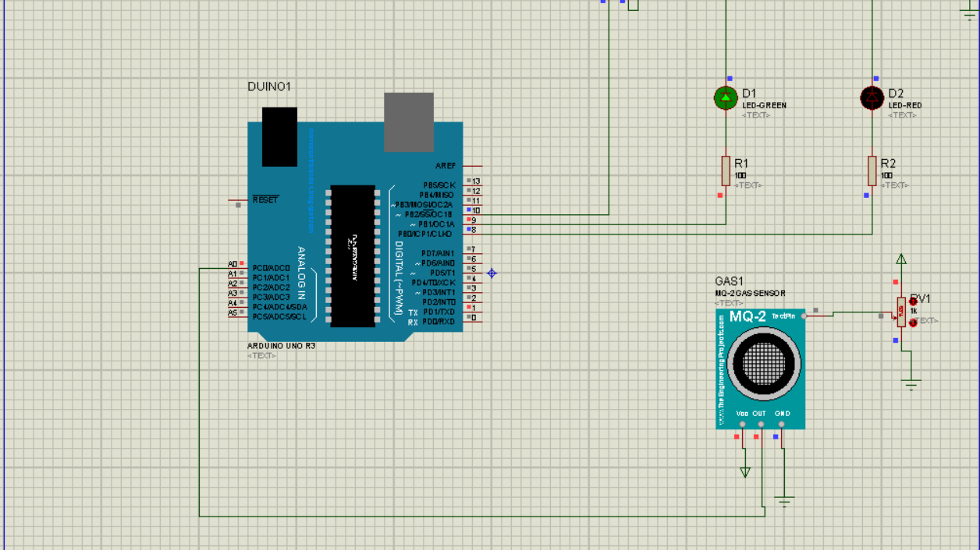
Circuit Diagram with Green LED ON

Slide 9

Circuit Diagram with
Red LED ON

Slide 10
Conclusion
The air pollution detector works fine giving a red signal and a buzzer alarm when subjected to high air pollution environment and green signal with no alarm when subjected to air pollution level below threshold.

Slide 11
THANK YOU

